Slide 1
CSCE 623 In Class Day 06
Synchronous session

Slide 2
Agenda for Day 06
Coding Activity for gradient descent (pseudocode from day 5)
Worksheet Part 1 – Evaluation Criteria
Questions & Break
Worksheet Part 2 – Potential Problems
Evaluation and problem-solving takeaways
Questions & Dismissal

Slide 3
Gradient Descent Coding Activity (group work, 20 min)
Acquire the starter code from Canvas
Complete Step 1 code to find the gradients for theta (β₀ and β₁)
Run the code
Examine the results to see the line slope & intercept changing
(optional) change the starting beta to see what happens to the iterative gradient descent

Slide 4
Gradient Descent Coding Activity Hotwash
How did it go? Did the code converge on a good solution?
What were the gotchas?

Slide 5
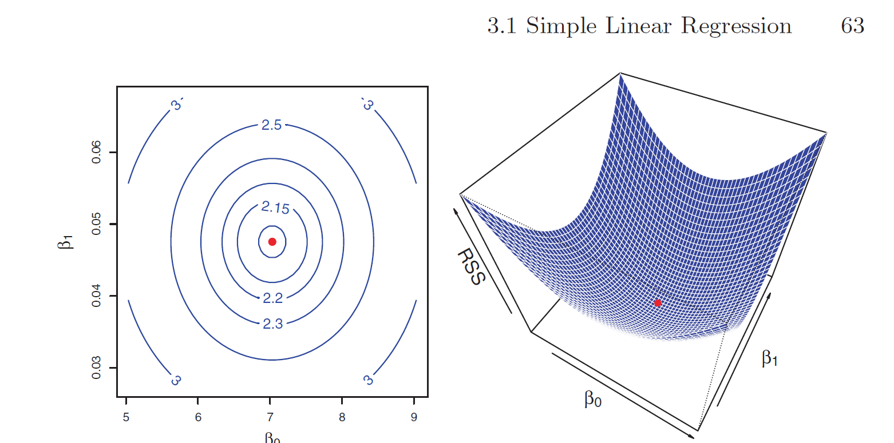
Code Review: main points
A gradient is an instantaneous slope at a point in the cost surface
The gradient points in the direction of reducing (increasing) RSS
Key Idea: If we alter theta by selecting values further down the gradient, we incrementally approach a better fitting model… but how far should we alter theta?
But choosing a step which is too large can lead to divergence instead of convergence
And Choosing a step which is too small can lead to slow convergence
By choosing a learning rate we control how big of a step to take down the gradient in each iteration

Slide 6
Evaluation Criteria Worksheet Activity – Part 1
Evaluation Criteria Learning Activity
Techniques to determine quality of fit for the model or for coefficients
Techniques to determine how datapoints influence the model
Worksheet:
Describe correlation, leverage, variance inflation
Breakout Groups – 10 minutes
Complete part 1
Be prepared to discuss

Slide 7
Key Concepts for ML – Part 2: Potential Problems
Problems that can be detected from residuals after the model is fit
Worksheet activity Day 06 part 2 (6 questions)
Nonlinearity
Correlation of Error Terms
Non-constant variance
Outliers
high-leverage points
collinearity
Breakout groups – 20 min
Work on the worksheet part 2 AND take a break if you need to

Slide 8
Key takeaways for evaluation and problem solving
There are some activities you can perform on the data before fitting a model - Might help you decide
Do you have more than one feature which contains the same information?
Do you need a pre-transform or scaling of features?
Do you need to drop outliers?
Is a linear model appropriate?
There are some activities you can perform once the model has been fit – Based on your residuals:
Are there patterns in the residuals that suggest alternate approaches?

Slide 9
Questions
Bonus discussion: To impute or not to impute?

